Slide 1

TCO ANALYSIS
Partners Enablement

Slide 2

AGENDA
What is Microsoft 365?
How to pitch Microsoft 365?
Why a comprehensive TCO Analysis is important
What is the TCO Analysis about?
Scope of the TCO Analysis
TCO Analysis Objectives
TCO Analysis Methodology
Live Simulation with Customer Data
Partners’ Kit
Q&A

Slide 3
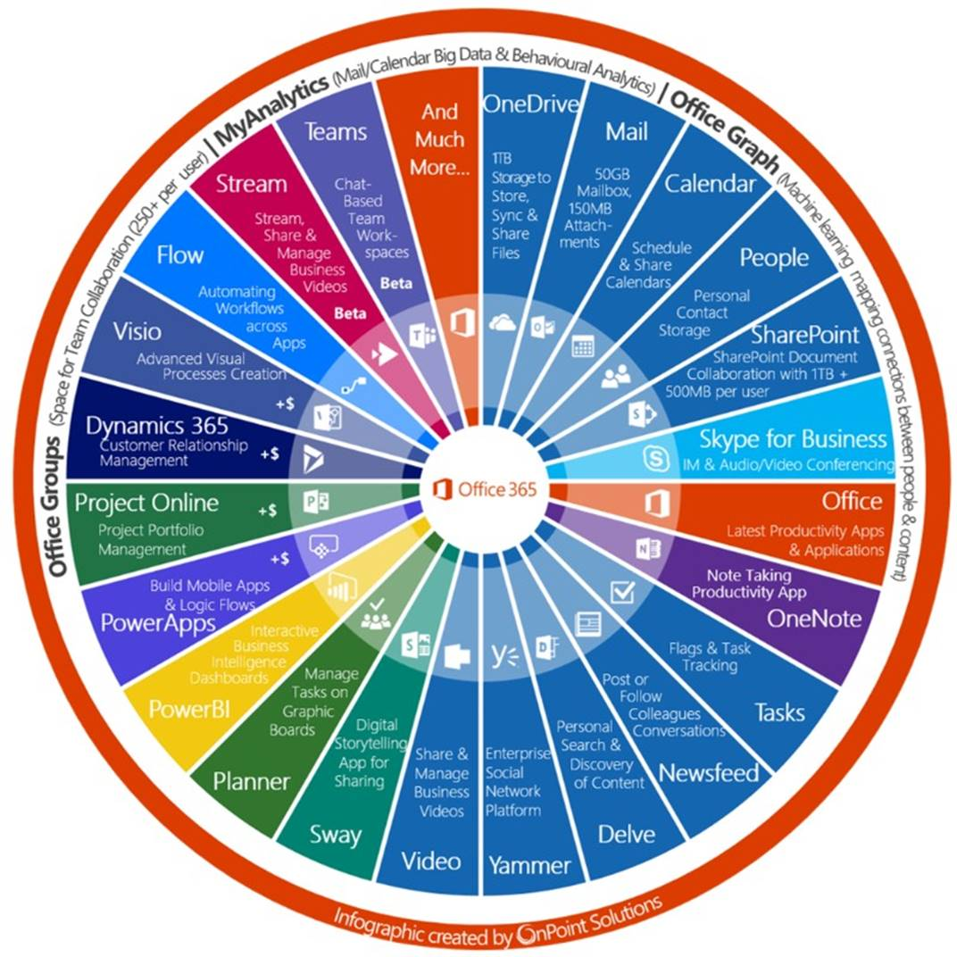
Office 365 is not
“Office in the cloud”!

Slide 4

WHAT IS OFFICE 365
A complete, intelligent solution that empowers everyone to be creative and work together securely.
It is built on the foundation of Secure Productive Enterprise.
Notes:
We are living in a time of inflection. Digital transformation is the biggest change any of us has seen in our lifetime. Companies invest in technology to optimize operations, transform products, engage customers, and empower employees. The challenge is finding the way to empower people to do their best work. This starts with fostering a culture of work that is inspiring for everyone, and embraces the trends in the workplace that make work inspiring.
To deliver on the tremendous opportunity for business growth and innovation, we are simplifying the customer experience by bringing together Office 365, Windows 10 and Enterprise Mobility + Security with the introduction of Microsoft 365.
It’s a complete, intelligent solution that empowers everyone to be creative and work together, securely. For enterprise customers, Microsoft 365 Enterprise is built on the foundation of Secure Productive Enterprise.

Slide 5

FOUR CORE PRINCIPLES OF OFFICE 365
Integrated for simplicity
Built for teamwork
Unlocks creativity
Intelligent security
Notes:
We are living in a time of inflection. Digital transformation is the biggest change any of us has seen in our lifetime. Companies invest in technology to optimize operations, transform products, engage customers, and empower employees. The challenge is finding the way to empower people to do their best work. This starts with fostering a culture of work that is inspiring for everyone, and embraces the trends in the workplace that make work inspiring.
To deliver on the tremendous opportunity for business growth and innovation, we are simplifying the customer experience by bringing together Office 365, Windows 10 and Enterprise Mobility + Security with the introduction of Microsoft 365.
It’s a complete, intelligent solution that empowers everyone to be creative and work together, securely. For enterprise customers, Microsoft 365 Enterprise is built on the foundation of Secure Productive Enterprise.

Slide 6

WHAT IS MICROSOFT 365
Office 365, Windows 10, Enterprise Mobility + Security
A complete, intelligent solution to empower employees to be creative and work together, securely.

Slide 7
AGENDA
What is Microsoft 365?
How to pitch Microsoft 365?
Why a comprehensive TCO Analysis is important
What is the TCO Analysis about?
Scope of the TCO Analysis
TCO Analysis Objectives
TCO Analysis Methodology
Live Simulation with Customer Data
Partners’ Kit
Q&A

Slide 8
HOW TO PITCH MICROSOFT 365
Negotiate and Close
Prepare a comprehensive proposal
Research your client’s industry
Submit the TCO Analysis report and present the outcome
Identify the use-cases
How to pitch M365
Propose to run the TCO Analysis
Demo the use-cases
Get your client to be convinced of M365

Slide 9

RESEARCH THE INDUSTRY
1
Understand your client’s industry
2
Use Microsoft FastTrack Productivity Library https://www.microsoft.com/en-us/microsoft-365/success/
3
Get familiar with the vocabulary used and the business scenarios

Slide 10

IDENTIFY M365 USE-CASES
Using again Microsoft FastTrack Productivity Library, identify the top use-cases of Microsoft 365 relevant to your client.
A use-case is a business scenario that Microsoft 365 could improve. It is a day-to-day task, process or activity that would be enhanced using Microsoft 365.

Slide 11

DEMO THE USE-CASES
Prepare and rehearse for a solid demo of the use-cases identified
The audience for the demo should not be the IT department but people from the business side (Sales, Marketing, Operations, Engineering, Warehousing, customer facing staff…)
Through your contacts in IT, request to have the demo with the right audience.
‘The session is not for the IT!’

Slide 12

GET THE CUSTOMER CONVINCED OF M365
Make sure to identify the decision makers (more than one)
Make sure they understand and value what M365 would bring to their organization
Get their approval to proceed with the financial evaluation
We need to avoid the technical evaluation (if there is no way around the technical evaluation, propose references and case studies of global references).
If the technical evaluation cannot be avoided, it has to be focused only to iron out some of the scenarios concerning the clients. Those scenarios need to be clearly identified.

Slide 13

PROPOSE TO RUN THE TCO ANALYSIS
Identify that the client is interested in the TCO Analysis (it might not be necessary)
Identify that the results will be appreciated and a business decision maker is involved. ‘Don’t waste your efforts with the IT team’
Use the TCO analysis if you identify any objection from the client’s side on the commercial aspect of moving to M365.
Make sure that the opportunity is properly qualified before you invest more in it (budget, timeline, compelling event, decision maker, competition)

Slide 14

RUN THE TCO ANALYSIS
TCO Analysis
Run the TCO Analysis making sure that the additional benefits that M365 will bring to the organization are captured as well.
Submit the detailed analysis
Present face-2-face the results
‘Preferably to have the full proposal ready during the same meeting!’

Slide 15

PREPARE A PROPOSAL
Prepare and submit a comprehensive proposal that should include the following:
Microsoft 365 Subscriptions
Deployment Services Scope of Work
Proposal to have a good look and feel and should include:
Introduction
Company Profile
Product Description
Scope of Work
Deliverables
Project Plan
Pre-requisites
Commercials
Payment Terms…

Slide 16

NEGOTIATE AND CLOSE
Return to the decision makers and summarize all the work that has been done.
Push for closure
Avoid discounting, show value.

Slide 17
RECAP: How to Pitch M365
Negotiate and Close
Prepare a comprehensive proposal
Research your client’s industry
Submit the TCO Analysis report and present the outcome
Identify the use-cases
How to pitchM365
Propose to run the TCO Analysis
Demo the use-cases
Get your client to be convinced of M365

Slide 18
AGENDA
What is Microsoft 365?
How to pitch Microsoft 365?
Why a comprehensive TCO Analysis is important
What is the TCO Analysis about?
Scope of the TCO Analysis
TCO Analysis Objectives
TCO Analysis Methodology
Live Simulation with Customer Data
Partners’ Kit
Q&A

Slide 19

WHY A COMPREHENSIVE TCO ANALYSIS IS IMPORTANT
Sometimes it is hard to justify the investment in Microsoft 365 without a proper TCO Analysis.
Running the TCO analysis will compare the costs of maintaining the system in the local data center moving them to Microsoft 365 (where applicable).
The results of the TCO will clearly show the total costs that your customer will incur over a period of 5 years for both the options which will help in justifying the investment.

Slide 20
AGENDA
What is Microsoft 365?
How to pitch Microsoft 365?
Why a comprehensive TCO Analysis is important
What is the TCO Analysis about?
Scope of the TCO Analysis
TCO Analysis Objectives
TCO Analysis Methodology
Live Simulation with Customer Data
Partners’ Kit
Q&A

Slide 21

WHAT IS THE TCO ANALYSIS ABOUT?
The TCO analysis compares the costs of running some your IT Services in your own data center versus moving them to Microsoft 365.
The analysis is conducted with your own data and feed to an Excel sheet with transparent calculation formulas.

Slide 22

SCOPE OF THE TCO ANALYSIS
Email Services
Users Personal Storage on File Server
3rd Party Application for file sharing and transferring
Files on Share Drive Servers
Hub for Teamwork
Microsoft Licenses
Anti-Virus
Single Sign-On
Device Management
Administration and Migration Services
Training and Adoption

Slide 23
TCO ANALYSIS OBJECTIVES
1
To answer the client’s concerns that Microsoft 365 is expensive
2
To help the client build the business case
3
A great value that you will bring to your client and that will be position you as a trusted advisor
4
Elevate your pitch from a license provider to a value partner
5
A way to connect again with clients
6
A great differentiator in the market

Slide 24
AGENDA
What is Microsoft 365?
How to pitch Microsoft 365?
Why a comprehensive TCO Analysis is important
What is the TCO Analysis about?
Scope of the TCO Analysis
TCO Analysis Objectives
TCO Analysis Methodology
Live Simulation with Customer Data
Partners’ Kit
Q&A

Slide 25
TCO ANALYSIS METHODOLOGY/PROCESS
Step 4
Get a price estimation for the professional services required to deploy Microsoft 365 and migrate the data.
Step 2
Set for a meeting with the contacts to collect the data required.
Step 6
Once the data is validated, generate the report and send it the client.
Step 8
Negotiate and close the deal.
Step 1
Set for a meeting to present the benefits of conducting a TCO analysis, discuss the process that you will follow and get the confirmation to start
Step 3
Compute the Microsoft 365 plans and if there is any add-on required.
Step 5
Enter all data in the TCO Excel sheet and validate the results back with the client.
Step 7
Generate a proposal and share it with the client.

Slide 26

STEP 1: Set for a meeting with your client to present the benefits of conducting a TCO analysis, discuss the process that you follow and get their confirmation to start
Once the contact at the client’s side has been identified, send the invitation email explaining briefly the process and requesting for a face-2-face meeting to go into more details.
If the client does not reply to the email sent, call the contact and request for the meeting or ask for the right person to talk to.
Keep repeating step b until the first face-2-face meeting is set.
During the 1st meeting, go through the customer facing presentation to explain the benefits and the process. The objective of the 1st meeting is to get the client’s approval to start the analysis and identify the contacts who will provide you with the data required to run the TCO tool.

Slide 27

STEP 2: Set for a meeting with the contacts to collect the data required
Once the rights contacts are identified, set for face-2-face meetings with them to collect the data required for the TCO analysis.
Use the data template (.xlsx) to collect the information required for the TCO analysis.

Slide 28

STEP 3: Compute the Microsoft 365 plans and any add-on required
Along with the sales account manager, compute the annual Microsoft 365 subscriptions required by the customer along with the add-ons (SharePoint additional storage required, 3rd party migration tools…)

Slide 29

STEP 4: Get a price estimation for the professional services required to deploy Microsoft 365 and migrate the data.
Request from your services department an estimation on how much will it the customer to deploy Microsoft 365 and migrate the data as per the requirements.

Slide 30

STEP 5: Enter all data in the TCO Excel sheet and validate the results back with your contact
All data collected must be entered in the Excel sheet and the results validated with your contact at the client’s side.

Slide 31

STEP 6: Once the data is validated, generate the report and send it the client
Once the data is validated with the client, generate the report and send it attached with the email summarizing the results.

Slide 32

STEP 7: Generate a proposal and share it with the client.

Slide 33

STEP 8: Negotiate and close the deal.

Slide 34
RECAP: TCO ANALYSIS METHODOLOGY/PROCESS
Step 4
Get a price estimation for the professional services required to deploy Microsoft 365 and migrate the data.
Step 2
Set for a meeting with the contacts to collect the data required.
Step 6
Once the data is validated, generate the report and send it the client.
Step 8
Negotiate and close the deal.
Step 1
Set for a meeting to present the benefits of conducting a TCO analysis, discuss the process that you will follow and get the confirmation to start
Step 3
Compute the Microsoft 365 plans and if there is any add-on required.
Step 5
Enter all data in the TCO Excel sheet and validate the results back with the client.
Step 7
Generate a proposal and share it with the client.

Slide 35
AGENDA
What is Microsoft 365?
How to pitch Microsoft 365?
Why a comprehensive TCO Analysis is important
What is the TCO Analysis about?
Scope of the TCO Analysis
TCO Analysis Objectives
TCO Analysis Methodology
Live Simulation with Customer Data
Partners’ Kit
Q&A

Slide 36

LIVE SIMULATION OF A CUSTOMER CASE

Slide 37
AGENDA
What is Microsoft 365?
How to pitch Microsoft 365?
Why a comprehensive TCO Analysis is important
What is the TCO Analysis about?
Scope of the TCO Analysis
TCO Analysis Objectives
TCO Analysis Methodology
Live Simulation with Customer Data
Partners’ Kit
Q&A

Slide 38
PARTNERS’ KIT
Invitation Email
Customers Presentation about the TCO Calculator
1-Pager
How-to Use Guide
TCO Calculator Excel Sheet
Output Report
Results Email
Partners Enablement on the TCO Calculator

Slide 39
AGENDA
What is Microsoft 365?
How to pitch Microsoft 365?
Why a comprehensive TCO Analysis is important
What is the TCO Analysis about?
Scope of the TCO Analysis
TCO Analysis Objectives
TCO Analysis Methodology
Live Simulation with Customer Data
Partners’ Kit
Q&A

Slide 40

Q&A

